Slide 1

Teen yoga
From stress to zen - the benefits & science

Slide 2
About me
My name is Cat Stuijt and I’m on a mission to take Teen Yoga across Wales.
I am the Teen Yoga Foundation Ambassador for Wales working alongside the TYF founder Charlotta Martinus.
I am also a self employed Dru Yoga and Dru Meditation teacher, having completed over 800 hours training in adult Dru Yoga, Dru Meditation, Dru Kids & Teens and Dru Yoga Dance as well as specializing further in Teen Yoga with the TYF.
The contents of this presentation are not absolute and I’d welcome your feedback.
To discuss further - My contact details are on the final slide.

Slide 3


Slide 4


Credentials

Slide 5

Why yoga for teens?
The benefits from a physical and mental perspective

Slide 6
How does teen yoga actually work?
Supporting teens in discovering a safe space, drawing out their authentic, empowered selves to co-create a compassionate community
It brings a sense of awareness to the mind, the body, the breath and brings them into unison
Understanding the capabilities of the body through posture (asana) work - aided by the breath, allowing one to go deeper inside and deal with life challenges by looking from the inside rather than the outside
Provides individuals with techniques to better deal with both physical and mental challenges
It gives you a toolbox to pull from when needed to calm and take time out
Mindfulness emerges the more you practise the physical aspect
Creates a shift in perspective

Slide 7
A few facts to consider
Health and wellbeing is now recognised as part of the curriculum
Neurodevelopment studies are using health and wellbeing as an intervention to look at social and emotional wellbeing to help young people learn
The benefits of yoga work hand in hand to help build resilience to life and learning
Currently there is a waiting time of 6 - 12 months to get an appointment for a Cognitive Behavioral Therapy session. There is a similar wait time to get an appointment with CAMHS (Child and Adolescent Mental Health Service)
For teens with stress/anxiety/depression - yoga can be used as an intervention and can be an additional support tool to someone in therapy
Small scale research results proved that those practising yoga versus those that don’t were far calmer and more comfortable with their own bodies

Slide 8
How to be well….the 7 step balance
Play
Sleep
Downtime
Connecting
Focus
Time In
Physical

Slide 9
Physical and mental teen challenges
PHYSICAL
Hormone Leptin kicking in
Skeletal growth
Development of Bone Mass Density
Longitudinal bone growth at the growth plate (cause of clumsiness)
Accelerated foot and hand growth
Female menstruation
Male voice break
Sexual organ development
Prefrontal cortex development and maturation and Cortisol levels
Hippocampus development
Postural challenges
Knock knees and flat feet
MENTAL
Anxiety
Depression
Self doubt
Desire to ‘fit-in’
Low self esteem
Self confidence levels
Lack of self respect
Competitiveness
Transition period
Independance
Bullying
Socio economic disadvantage
Discrimination
Self harming
Anger management

Slide 10
Understanding the growth spurt differences between genders
Boys
Growth spurt age 14 - 15 (average 9 cm)
Average end age 20
Hands & feet grow first then calves, forearms, hips and chest then shoulders
Strength in upper body develops through the pectorals
Girls
Growth spurt age 12 - 13 (average 8 cm)
Average end age 18
Hands & feet grow first then calves forearms, hips and pelvis
Develop waist and hips moving from a straight body to more curves
Breasts develop

Slide 11
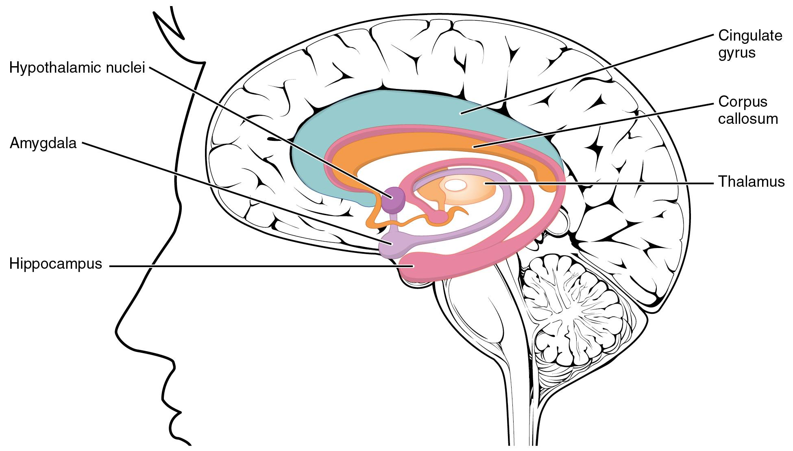
Understanding neuroscience during growth
Development of the Hippocampus
The maturation of the Prefrontal Cortex
Remodelling of Neuroplasticity
Hot and cold Cognition
Underdevelopment of the Prefrontal Cortex
Balancing the Amygdala (emotions) and the Prefrontal Cortex (reasoning)
Imbalance creates a decrease in reasoned thinking and an increase in impulsiveness
The risk factor

Slide 12
Understanding anatomy during growth
Bone mass - 90% is formed by the end of puberty
Rise in oestrogen and testosterone
Onset of puberty - menstruation for girls and voice deepening/facial hair growth in boys
Posture
Ligaments
Bone structure
Fascia and muscle tightness
Muscle tone
Pelvic angle
Joint position and mobility
Changes in weight and composition
Stress levels

Slide 13
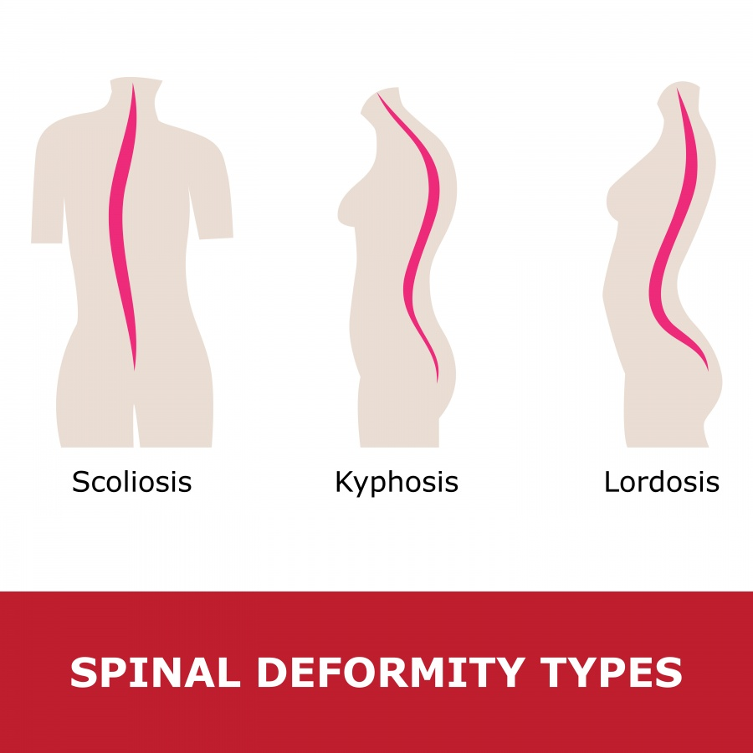
Postural challenges caused by lifestyle
Scoliosis
Lateral curvature of the spine
Alters body alignment
Leg lengthening discrepancy
Kyphosis
Rounded back
Humpback
Dowagers hump
Poor posture / phone and laptop neck
Lordosis
Typical in Afro Caribbean
Typical in gymnasts and ballerinas

Slide 14
Some of the other key challenges teens face
How does modern society affect sexuality and young people?
More easily accessible pornography
Snapchat images
TV (soaps) and pre watershed
Open culture
Openness re sexual orientation
TV ads for contraception and sexual pleasure
Social media
Exam pressure
Peer pressure
Lacking a sense of purpose and belonging
Drugs and alcohol addiction
Modern society
Home issues
Most recently - isolation and Covid-19

Slide 15

1st key challenge response
HOW MIGHT YOGA HELP YOUNG PEOPLE TO ADDRESS/AVOID ADDICTION?
Building bonds in a group
A distraction
Understanding healthy bodies and anatomy
Working with what makes them feel good about themselves physically and mentally - getting a buzz/high from yoga
Developing a home practice
A safe environment away from other temptations

Slide 16

2nd key challenge response
HOW MIGHT YOGA HELP ‘AT RISK’ TEENAGERS?
I'm ok just as I am - self acceptance using positive affirmations
Relaxation & meditation - quiet time aiding better sleep
Having patience and losing frustrations
Increasing self awareness
Gaining compassion for others/self/nature/world
Observing things differently
Thinking about nature differently
Linking in to a spirituality (non-religious)
Self love & self respect

Slide 17
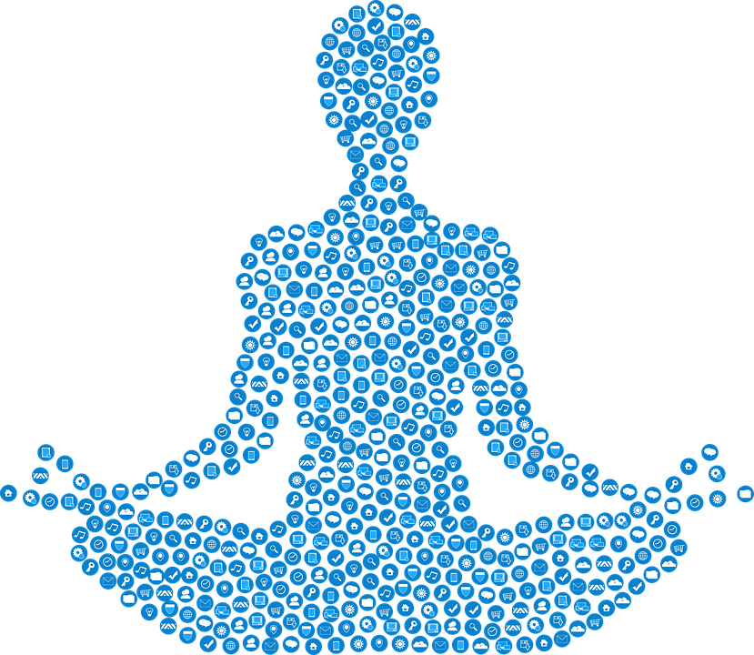
Aiding integration to society
How might yoga help with integration within society and with coherence of the inner experience with outer expression?
Yoga teacher as a role model - empathise, listen, observe
Small group bonding. Feeling united as a team
Learning new social skills in a non school classroom environment
Accepting the change of inner feelings and being able to express these outwardly - through physical movement or verbally
Building confidence and allowing the true self to develop outwards
As you become confident of own body and mind it will give a new perception on life and situations and being able to feel more comfortable in society
Learning to love the yoga class and happy to continue to practice into adulthood
Working with a different mindset & thinking things through - being aware of what your actions have on others - what effect your words may have on others
Learning about compassion for oneself and for others
Developing honesty and integrity
Making precious time for oneself - to practise and reflect
Seeing the world in a fresh way - away from social media

Slide 18
How does social media impact the way we find identity? (compared to identity pre-social media)
Self discovery pre social media was more of a self discovery journey without a barrage of external factors influencing the thought paths
Influences back then were purely looking at peers and influencers in our much smaller networks
There was less information clash
Now there is so much bragging - especially body beautiful - on Instagram
Makes it much more difficult to accept oneself and to carve out who we really are from the inside out

Slide 19
How can identity acceptance and realisation be made easier with yoga?
Focusing on the physical body and accepting what it can do rather than what it can't
Pausing for thoughts - how do I feel today? What am I thinking?
Taking time out for oneself in a small group or 1:1 without the phone/ipad intrusion
Enjoying that time out and making changes to time spent outside the class on social media making comparisons to others
Embracing honesty - allowing oneself to be natural in class and not being the happy go lucky social media self - drop the masks and the acting and pretending - working with acceptances

Slide 20

How do we encourage compassion and decrease egocentricity in a yoga class?
Through empowerment and praise and using students to demonstrate yoga postures
Pair work with opposites and same types - mix it up
Group work - friendship circles (mandalas) - support each other
Use of language that enforces kindness
Positive praising and encouragement
Yamas and Niyamas - Yoga Philosophy

Slide 21
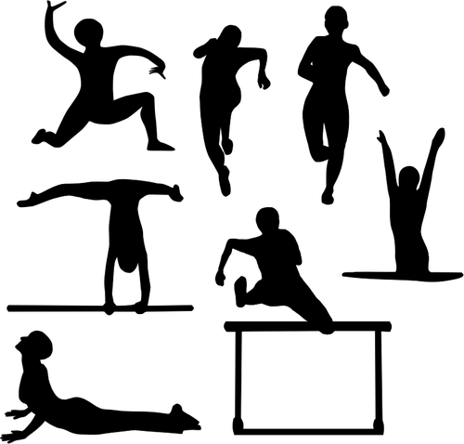
Benefits of yoga to support sports teams
Improves balance
Builds overall body strength
Develops Proprioception
Improves ankle and knee stability
Builds core strength
Provides stretch to muscle and fascia
Spinal health
Improves posture
Bilateral balance
Pranayama (breath work) for improved cardiovascular and for settling, relaxation and focus
Team connection
All sports

Slide 22
Gather
Happy
Allow Yourself
Safe
Let Go
Observe
Calm
Curious
Listen to Yourself
Be in the Here & Now
Tune In
Be Present
Kind
Breathe
Attentive to me
Acceptance
Focus
Open
Flow
Loving
Celebrate

Slide 23
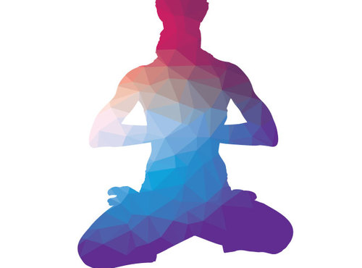
What do I hope to achieve?
What does success look like?

Slide 24
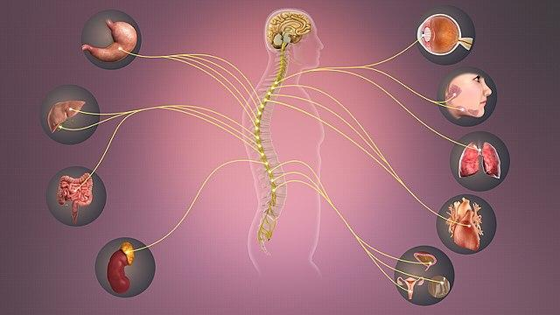
Being able to switch from being hyper to being calm and nurturing
It is a great skill to be able to move in an agile way between the sympathetic and parasympathetic nervous systems
Having the tools to recognise the fight or flight of the sympathetic to the rest and digest of the parasympathetic
In a yoga class moving from back bends and sun salutations (sympathetic) to resting in relaxation forward bends (parasympathetic) to balance both

Slide 25


Some example statements from students
I'm more positive
I'm kinder to myself
I'm kinder to others
I'm more tolerant
I'm more in the present moment
I worry less
I can deal with things
I can call upon my tools - yoga movement, pranayama, meditation
I'm calmer
I am less impulsive
I can self heal to a degree
I can prioritise what really matters vs trivia

Slide 26
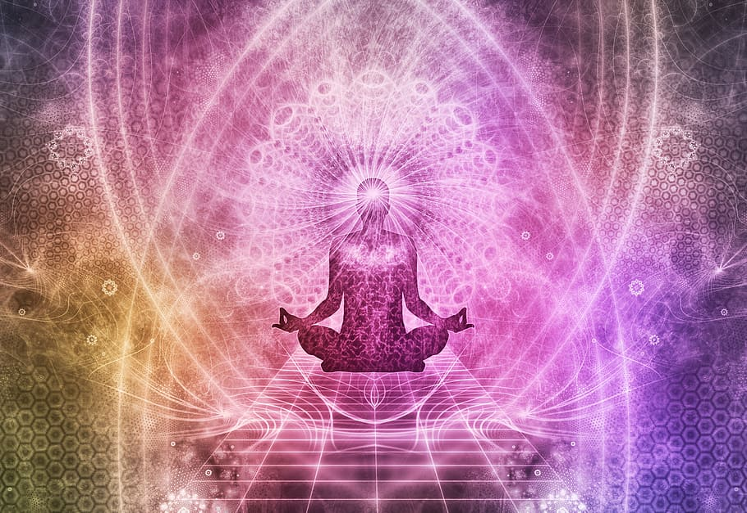
Connection of teacher and students
Karma
Having awareness in yoga class - how are students responding (reacting) - what are they feeling (thoughts) - what actions result from this? Are they positive?
Do we recognise negative thoughts and manage to turn these into a positive action?
Prana
Breathing techniques
Awareness of the breath in asana practice
Appreciating the freedom of movement that prana brings
Life Lessons
Understanding that a difficult asana is just a new lesson

Slide 27
Connection of teacher and students
In the Moment
Allowing the yoga lesson to be 'right here, right now'
Clearing the mind of what has passed
Not worrying about the future whilst being in the present moment
Resistance
Trying new things/yoga techniques
Learning how to surrender and give it a go
Courage and Trust
Strength and courage in oneself to try yoga techniques

Slide 28
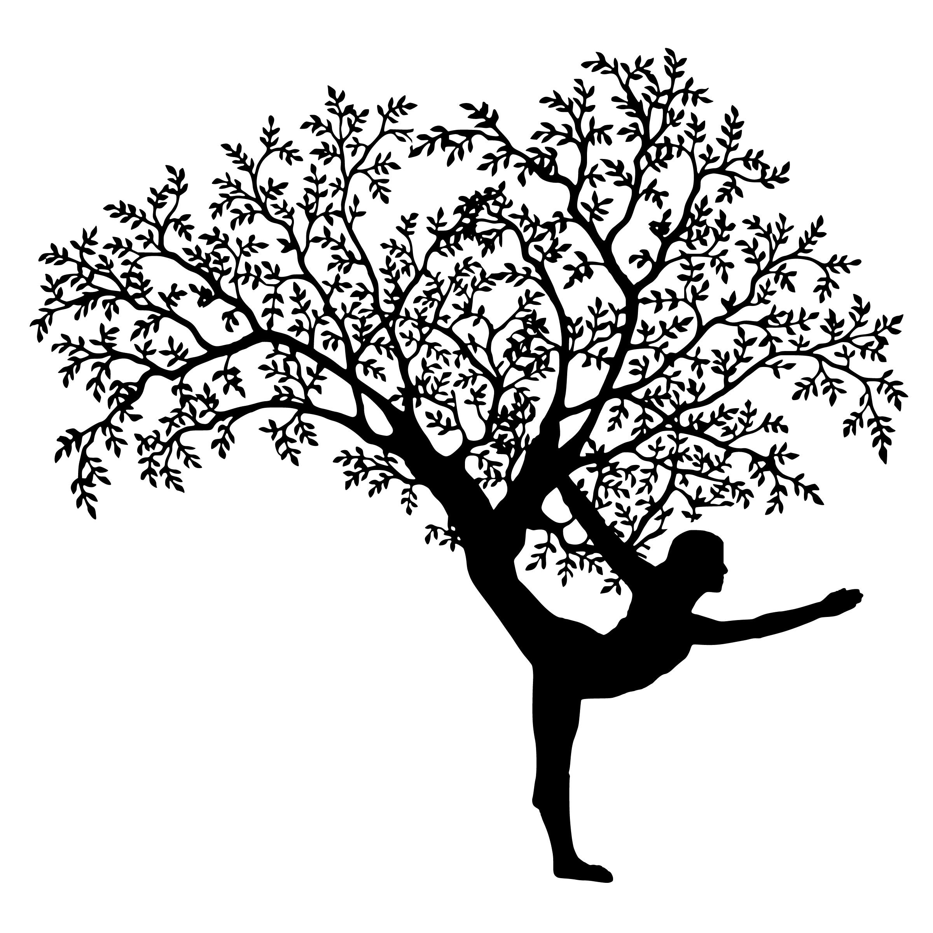
Conclusion
Yoga gives everyone the opportunity to develop a strong foundation and the tools to use for the rest of life

Slide 29
Thank you
Contact Details
cat@trudruyoga.co.uk
07816 103064
https://www.trudruyoga.co.uk/wales/for-kids-teens/
https://www.facebook.com/TruDruYoga/
https://www.instagram.com/tru.dru.yoga/
Costs and packages are on a tailored basis depending on your requirements and circumstances

